Slide 1
2
Describing the Distribution of a Single Variable

Slide 2
Introduction (slide 1 of 2)
The goal is to present data in a form that makes sense to people. Tools that are used to do this include:
Graphs: bar charts, pie charts, histograms, scatterplots, time series graphs
Numerical summary measures: counts, percentages, averages, measures of variability
Tables of summary measures: totals, averages, counts, grouped by categories
It is a challenge to summarize data so that the important information stands out clearly.

Slide 3
Introduction (slide 2 of 2)
There are four steps in data analysis:
Recognize a problem that needs to be solved.
Gather data to help understand and then solve the problem.
Analyze the data.
Act on this analysis.
It is up to you to ask good questions—and then take advantage of the most appropriate tools to answer them.

Slide 4
Populations and Samples
A population includes all of the entities of interest in a study (people, households, machines, etc.)
Examples:
All potential voters in a presidential election
All subscribers to cable television
All invoices submitted for Medicare reimbursement by nursing homes
A sample is a subset of the population, often randomly chosen and preferably representative of the population as a whole.
Examples: Gallup, Harris, other polls today

Slide 5
Data Sets, Variables, and Observations
A data set is usually a rectangular array of data, with variables in columns and observations in rows.
A variable (or field or attribute) is a characteristic of members of a population, such as height, gender, or salary.
An observation (or case or record) is a list of all variable values for a single member of a population.

Slide 6
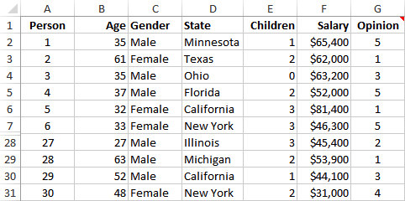
Example 2.1: Questionnaire Data.xlsx
Objective: To illustrate variables and observations in a typical data set.
Solution: Data set includes observations on 30 people who responded to a questionnaire on the president’s environmental policies.
Variables include: age, gender, state, children, salary, opinion.
Include a row that lists variable names.
Include a column that shows an index of the observation.

Slide 7
Types of Data (slide 1 of 5)
A variable is numerical if meaningful arithmetic can be performed on it.
Otherwise, the variable is categorical.
There is also a third data type, a date variable.
Excel® stores dates as numbers, but dates are treated differently from typical numbers.
A categorical variable is ordinal if there is a natural ordering of its possible values.
If there is no natural ordering, it is nominal.

Slide 8
Types of Data (slide 2 of 5)
Categorical variables can be coded numerically or left uncoded.
A dummy variable is a 0–1 coded variable for a specific category.
It is coded as 1 for all observations in that category and 0 for all observations not in that category.
Categorizing a numerical variable by putting the data into discrete categories (called bins) is called binning or discretizing.
A variable that has been categorized in this way is called a binned or discretized variable.

Slide 9
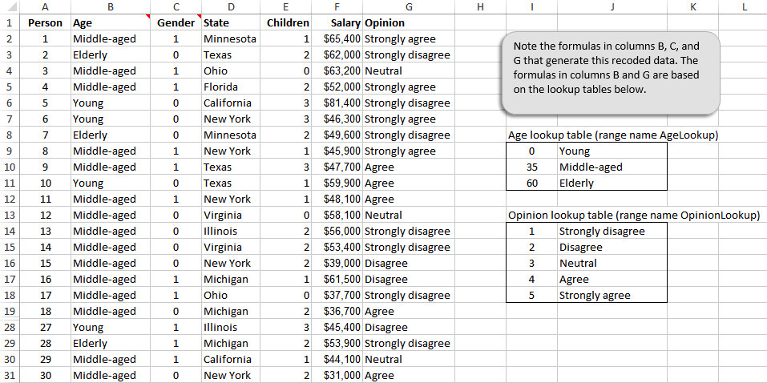
Environmental Data Using a Different Coding (slide 3 of 5)

Slide 10
Types of Data (slide 4 of 5)
A numerical variable is discrete if it results from a count, such as the number of children.
A continuous variable is the result of an essentially continuous measurement, such as weight or height.
Cross-sectional data are data on a cross section of a population at a distinct point in time.
Time series data are data collected over time.

Slide 11
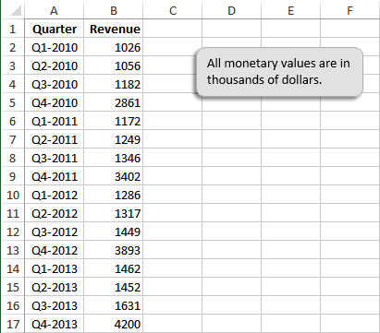
Typical Time Series Data Set (slide 5 of 5)

